Slide 1
Random Forest
What is a Random Forest?
A random forest is a meta estimator that fits a number of decision tree classifiers on various sub-samples of the dataset and uses averaging to improve the predictive accuracy and control over-fitting
Bootstrap
Bagged
Decision Tree
Random Forest
Decision
Tree
Fig 1 : Block diagram on how Random Forest is generated
Page 4

Slide 2
Support Vector Machines
Within Logistic Regression (decision boundary) or in case of regression problem we will have linear line fitting over the data.
Question do we get the best line or the best decision boundary?

Slide 3

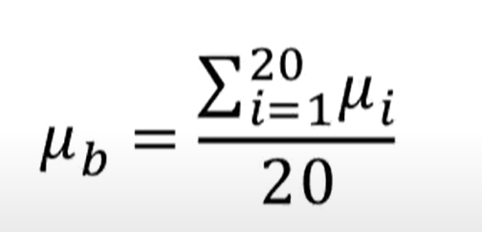



Random Forest
Bootstrap
It simply means “sub-sampling with replacement”
For example : Lets just assume we 100 random numbers
10,3,4,5,32,69,24,81…70,9,12
Find Mean
For Bootstrap let us draw 20 times with a sample of 30 numbers with replacement
11,2, 7,25,85…70,10
13,8, 17,23,89…72,67
1,4, 12,25,90…91,48
Why to use bootstrapped mean over normal mean?
Reduces Variance
Page 4

